Slide 1

The Big Ideas
Roadmap 19-20
How can the Tech Department help to increase student engagement and student achievement?

Slide 2

Overview of Initiatives for School Year 19-20
Mobile Applications
Student Certifications
CTE Programming Support
Student Support Desks
eSports and Competitive Gaming
Interactive Display Boards
Augmented and Virtual Reality
Dual Data Centers and Redundancy
Improvements to the Computer Fleet
Minimizing Inventory Losses

Slide 3
Mobile Applications (Shield and Spear)
GOAL Academy will be the first school in Colorado to develop and release a dedicated mobile application for both staff and students!
  Ease of use
  Better use of tech resources
  Empower staff
  Speed time to resources
  Enable anywhere, anytime academics
  Increase engagement
  Increase achievement

Slide 4
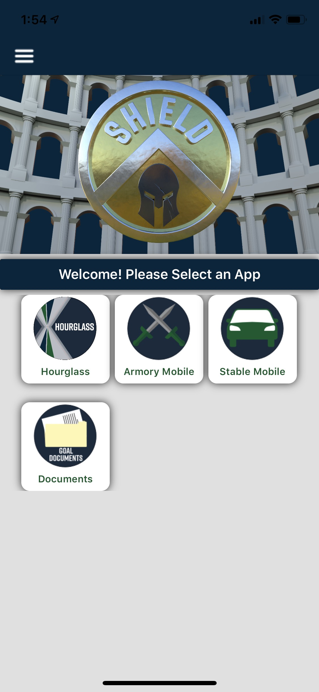
Shield – Releasing August 1st, 2019

Slide 5
Spear – Coming 2020
Spear is the student focused mobile application. Highlights include:
  Secure communications through Microsoft Teams plug-in
  Academic content delivery through Schoology
  Quick work capability through Office 365 applications
  Geolocation services to assist with MIA students
  Geolocation services to assist families with community support organizations
  Geolocation services to expose site-based activities and calendars
  Social plug-ins for students to share their experiences with the GOAL community
  Data connections to allow students to access their own data
  And much, much more!

Slide 6



Student Certification Support
Student certifications in technology disciplines GREATLY prepare students for a career in technology!

Slide 7
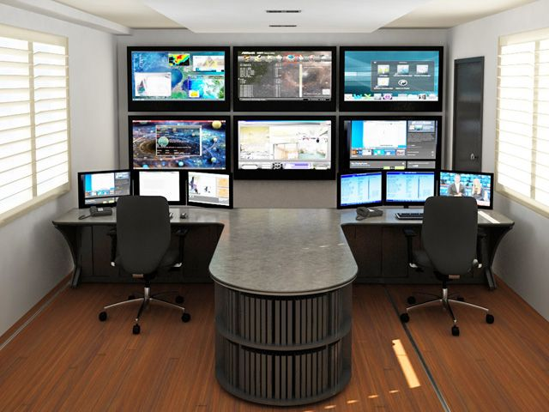
CTE Programming and Support
We look forward to working with our Academic team and our new CTE Coordinator!
Cybersecurity program – Peyton (Patriot) Campus
  Full Network Operations Center
  Cybersecurity curriculum
  Cybersecurity training equipment and simulations
Works hand in hand with student certifications!
  CompTIA Security+

Slide 8

Student Support Desks
Students helping students!
  Students in the CTE program will have an opportunity to gain real-world experience by serving on a Student Support Desk
    Will support students in-region
    Some staff support
  Overseen and supported by full-time Tech staff
  GREAT preparation for entry job in Tech

Slide 9
eSports and Competitive Gaming
eSports is a worldwide competition where players compete to win prizes.
  There are professional leagues with payouts in the millions!
The Colorado High School Activities Association (CHSAA) is running eSports as a pilot program for 2019-20, with a full sanction and interschool competitions planned for 2020-21 school year.
eSports can give GOAL students the chance to complete against other schools in statewide events!
  We have sponsors! Microsoft and HP!
Students in this program must be fully engaged and passing all classes at a “C” or better

Slide 10
Interactive Display Boards
Imagine a 65-inch touchscreen, with integrated cameras and speakers, AND Windows 10 built right into the device!
  Each GOAL site is getting at least one unit, larger sites are receiving more
  Will allow for fully remote video meetings
  Can broadcast from Administration to every board in the state at the same time, using the power of our A/V team to create our own channel
  Can assist our Academic teams with delivering more interactive content, recording those sessions, and making them available to students on-demand

Slide 11
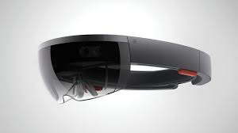
Augmented (AR) and Virtual (VR) Reality
Augmented and Virtual Reality curriculum offers students a completely new way to interact with their work.
  Students can experience working with virtual models of what they are studying at that time
    Health classes – could be a working respiratory system
    Automotive classes – could be an interactive transmission
    Tech classes – could be the insides of a computer
GOAL is relying on our Microsoft partnership to bring the HoloLens device to our school!

Slide 12

Dual Data Centers and Redundancy
So, how do we power all this advanced technology?
  Dual Data Centers!
    Pueblo
    Colorado Springs (under construction, operational 1 August 2019)
Our data centers offer us enormous capacity and capabilities and offer disaster recovery times that are the best in the industry. When our data centers are complete, GOAL will never be out of sync on any data or process by more than one minute!

Slide 13
Improvements to the Computer Fleet
To aid in the deployment of advanced services to students, we have embarked on upgrading the entire fleet of computers.
  Thank you, Board Members!
New fleet moves from a 32GB storage, older processor, to a 64GB storage and newer processor
  Allows for smoother testing delivery
  Can run tech simulations for possible CTE curriculum
  Can work with AR/VR curriculum
  Can run other advanced software, such as adaptive aids or Minecraft
New fleet will be deployed to sites by 26 July 2019, earliest ever
Hotspot fleet is also being refreshed for 2019-20, through our T-Mobile partnership

Slide 14
Minimizing Inventory Losses
With all the new technology to be deployed in 2019-2020, it’s more important than ever to exercise strong inventory management processes.
  Shield Mobile App is key
    Built-in scanning through phone camera
    Geolocation and site selection to ensure assets are tied to the correct site
    Ongoing support and training for all staff that interact with inventory through our new IT Relationship Generalist
    Regular auditing practices with our Administrative Assistant team at sites
  Spear Mobile App is key, as well
    Geolocation services to help locate MIA students, thus helping recover assets

Slide 15
There is so much more!
Showcase School and Microsoft Partnership expansion
Building connections to underserved areas in Colorado through community partners
Modernizing the Student Information System
Expanding our partnerships with carriers, Comcast and T-Mobile
Building and reporting operational data for Tech, Finance, HR, Operations
Building more and more customized applications for staff and students
Continuing to harden security across the school and ensure compliance

Slide 16
Thank you for a great 2018-2019!
And onward to an even better 2019-2020!

